Slide 1
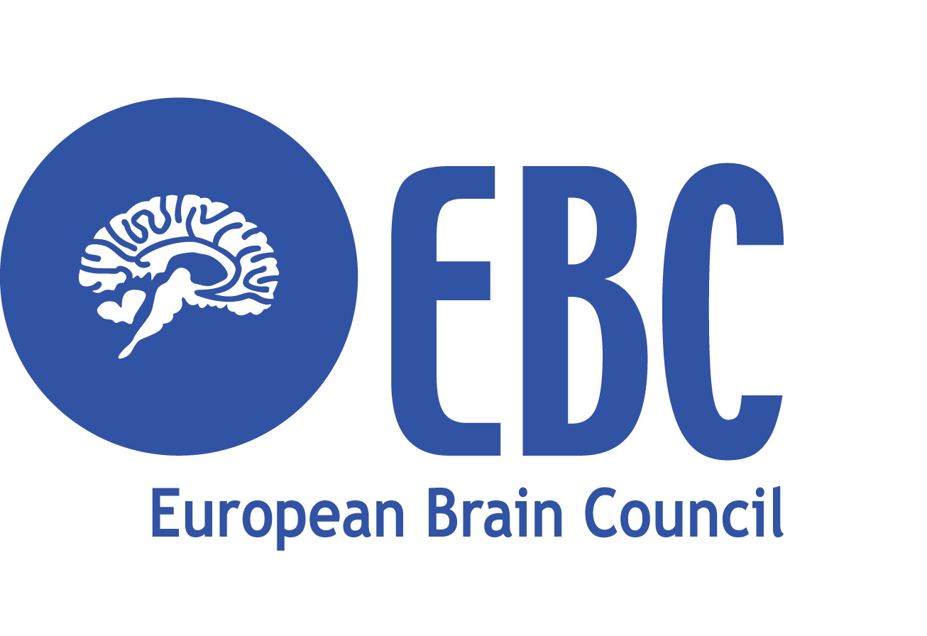
SANT Committee Meeting
17 October 2024
Prof. Claudio Bassetti,
Vice-President, European Brain Council
Former President & Board Member, European Academy of Neurology

Slide 2
Standing United for the Brain
National Brain Councils & Industry Partners
Notes:
A non-profit organisation based in Brussels, its main mission is to promote brain research with the ultimate goal of improving the lives of the estimated 179 million Europeans living with brain conditions. With the aim to speak with one voice, EBC stands as the platform to foster cooperation between its member organisations and other stakeholders, consistently promoting dialogue between scientists, industry and society.

Slide 3
The Burden of Brain Disorders
© European Academy of Neurology / Brain Health Mission
Notes:
Posing the burden of neurological disorders at the global level and WHO European region
Global data, trend growing and staggering as the population ages, brain disorders are #1 disabler and #2 killer

Slide 4
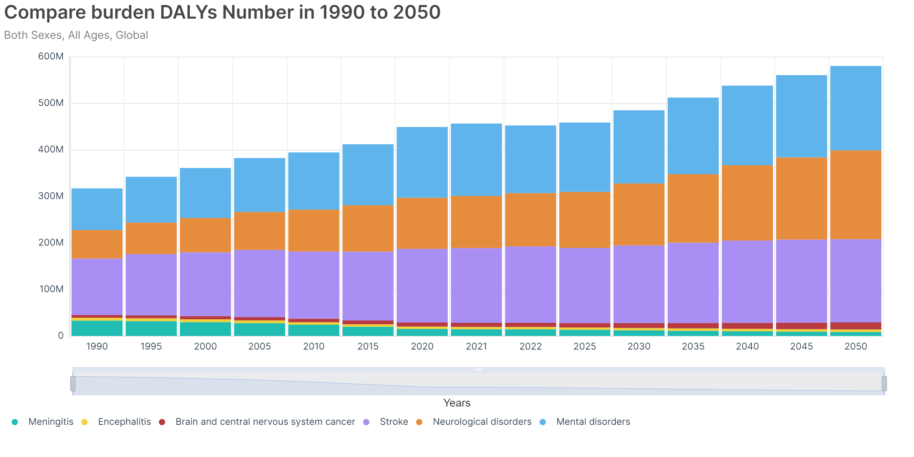
The Burden of Brain Disorders
Institute for Health Metrics and Evaluation (IHME). Findings from the Global Burden of Disease Study 2019. Seattle, WA: IHME, 2022.
Notes:
DALYs of neurological disorders and related disorders of the brain – note that stroke is technically also categorized as a neurological disorder
Global data, trend growing and staggering as the population ages, brain disorders are #1 disabler and #2 killer

Slide 5
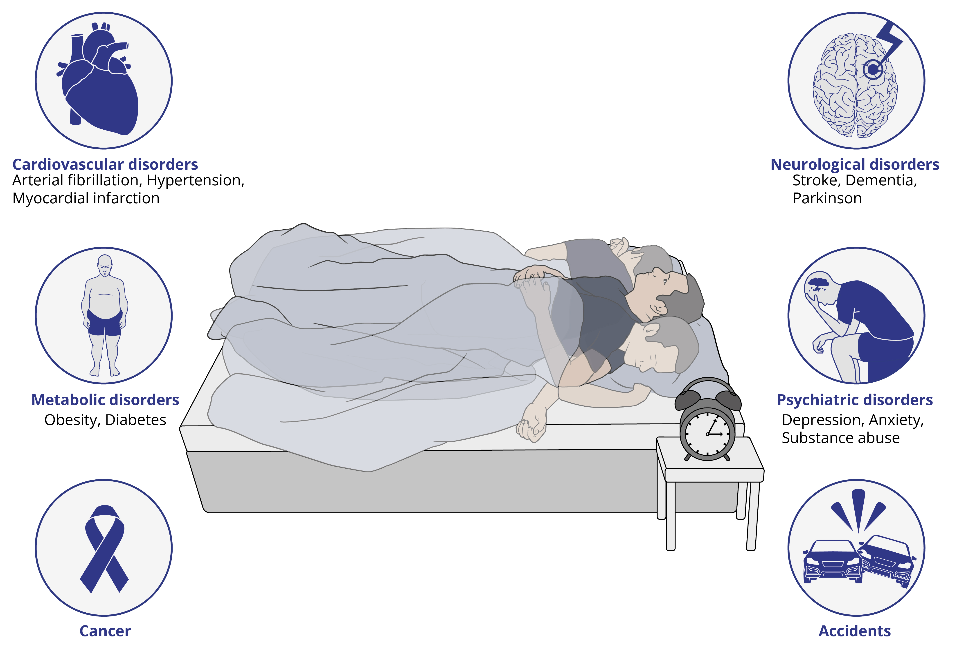
Neurological Health and the “Big 4”
Notes:
Interaction between neurological health and ill-health with other disorders

Slide 6
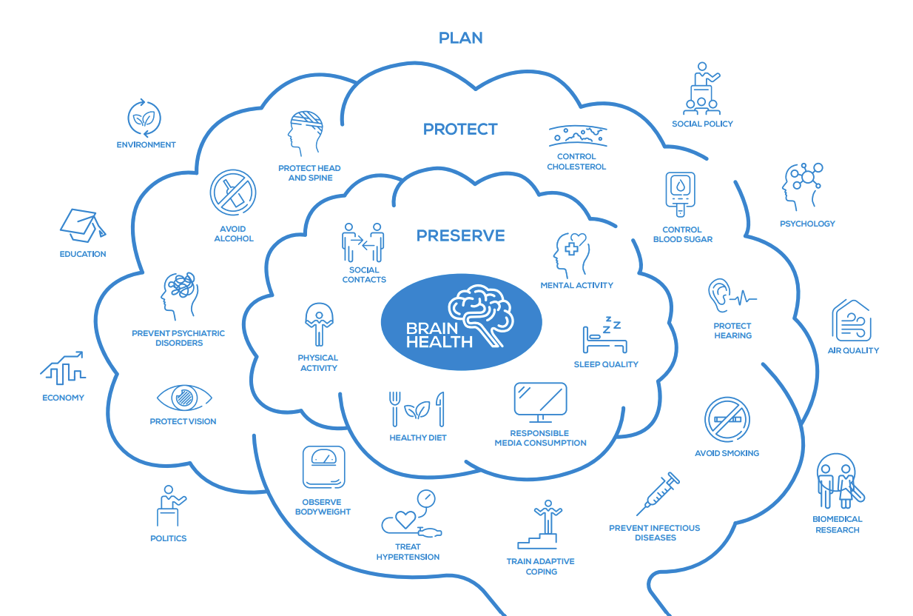
From neurological and mental health to Brain Health
© European Academy
of Neurology
Notes:
There are 400 classified neurological conditions and 200 psychiatric disorders, which include epilepsy, depression, Alzheimer’s disease, Multiple Sclerosis, Parkinson’s, depression, stroke, Schizophrenia, headache, anxiety disorders, chronic pain and rarer brain disorders such as amyotrophic lateral sclerosis (ALS), dystonia and ataxia affecting over 179 million EU citizens of all ages.
Most recent study on Burden of neurological disorders (Steinmetz et al) publish in Lancet (Neurology) in spring this year states more than 43% of global population is affected by neurological disorder.
These conditions fall under the term “brain conditions”, acting as an umbrella encompassing both neurological and mental disorders. Brain health is a growing priority across Europe and worldwide, exerting a massive toll on patients and their families, but also on labour markets, economies, and societies at large. Neurological and mental conditions make of brain disorders the #1 cause of disability and the second leading cause of death worldwidei, accounting for over 18% of total health lossii. And this burden will keep on growing as the European population ages.

Slide 7
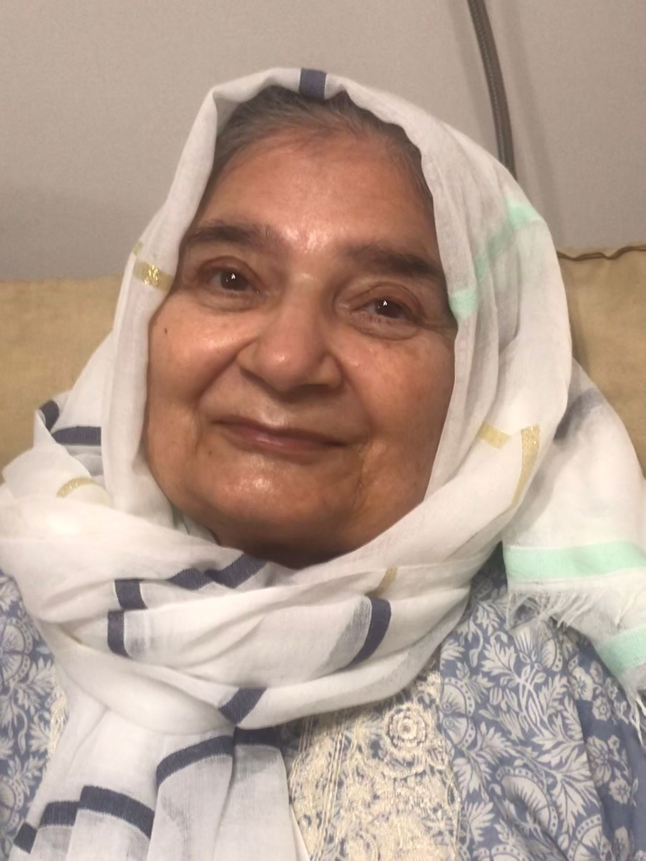
Definition of Brain Health
We must seek to maintain a state of brain functioning across cognitive, sensory, social-emotional, behavioural and motor domains, allowing a person to realize their full potential over the life course, irrespective of the presence or absence of disorders.
WHO definition of Brain Health
Notes:
Multitude of definitions, such as “Brain health should be interpreted as a concept that encompasses neural development, neuroplasticity, brain functioning, and recovery across the life course, including mental health and wellbeing elements.” from the European Commission.
As defined by the World Health Organization (WHO), brain health is “the state of brain functioning […] allowing a person to realize their full potential over the life course, irrespective of the presence or absence of disorders.”
In the context of the upcoming European Partnership for Brain Health, the European Commission chose a more comprehensive understanding of brain health, defined as “a concept that encompasses neural development, neuroplasticity, brain functioning, and recovery across the life course, including mental health and wellbeing elements.”

Slide 8
A Growing International Momentum on Brain Health
Comprehensive Mental Health Action Plan 2013 – 2030
Global Action Plan on the Public Health Response to Dementia 2017 – 2025
Intersectoral Global Action Plan on epilepsy and other neurological disorders (IGAP) 2022 – 2031
2025
2030
Current EP Mandate
Notes:
Several action plans have been designed by WHO, endorsed by Member States, and have converging deadlines towards 2030. EU not on track to meet SDGs #3. Need to act within this mandate.
Faced with this urgent need for action, the WHO has adopted multiple plans for mental health, for dementia and for epilepsy and other neurological disorders, thereby requiring from Member States to commit to addressing the burden of brain disorders in a cohesive manner, notably by establishing national brain strategies by 2030-2031.
This momentum has been echoed at the European Union level, with the recent Comprehensive Approach to Mental Health, the Healthier Together initiative, the Horizon Europe Framework Programme for Research and Innovation, and more specifically the upcoming European Partnership for Brain Health.
However, in the current context of increased focus on competitiveness and innovation, an overarching plan for the brain at the EU level would allow for streamlining of resources, avoiding duplication of efforts while maximising policy impacts for the millions of Europeans living with a brain condition, but also their families, carers, and societies at large.

Slide 9
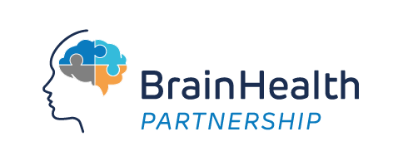
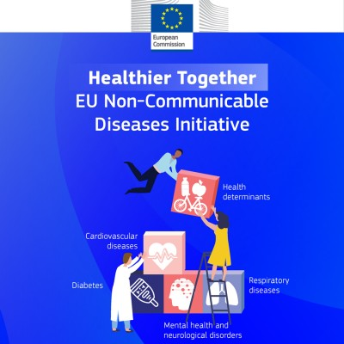
A Growing European Momentum on Brain Health
Horizon Europe: EU Partnership for Brain Health (2026-2036)
Healthier Together: Mental Health & Neurological Disorders (Upcoming)
EC Priorities:
Competitiveness and Innovation
Skills and Education
Notes:
[add by MC]:
European Commission is already moving ahead with some initiatives to support brain health:
EU partnership for Brain Health: Decade long partnership with €300 million to foster research into understanding the brain and furthering discovery of new treatments.
Healthier Together: Sharing best practices in health policy to tackle non-communicable diseases, of which neurological disorders are the most costly and disabling.
Not enough: While both initiatives are welcome, they are not enough to reach goals of Intersectoral Global Action Plan and the Mental Health Global Action Plan, Europe needs a coordinated strategy in order to support member states in developing national plans and to embed brain health across all policies.
Within this momentum - a robust parliamentary mechanism is established in order to ensure a transversal oversight of all current and future initiatives, in a cohesive and efficient manner.

Slide 10
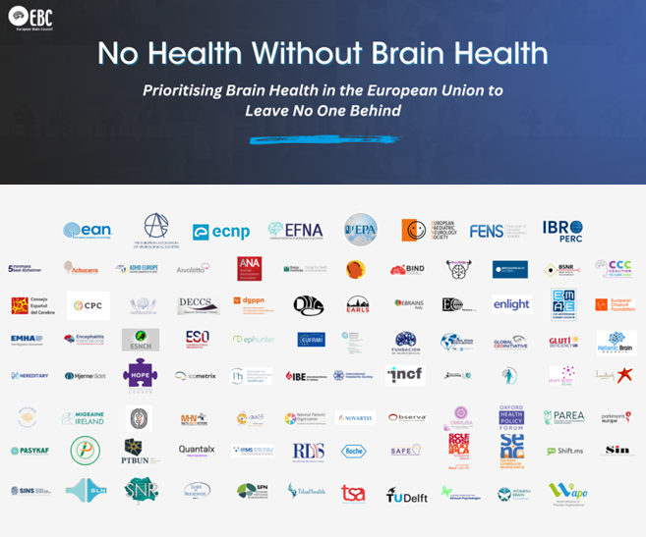
Calling for an EP Intergroup on Brain Health & Research and EU Coordination Plan for the Brain
Calling on all policymakers to recognize that brain health as a whole needs to be addressed in all policies, through the development of:
An EP Intergroup on Brain Health, to serve as a platform to foster collaboration between MEPs, experts, stakeholders, and civil society and coordinate current policy efforts.
An EU Coordination Plan for the Brain to tackle brain health in a collaborative, integrated and comprehensive manner.
110+ Supporting Organisations
Notes:
Promote the development of EU and national brain plans to tackle brain disorders,
Drive increased attention for brain health, not only from within the wider brain community but also from EU policymakers and the public,
Influence the EU policy agenda and initiatives that will make a significant difference for people living with brain disorders,
Facilitate the exchange of best practices between Member States.
EU Member States and associated countries to implement public health programmes addressing brain health in a systematic way.
The European Union to come forward with an EU Coordination Plan to tackle brain health in a collaborative, integrated and comprehensive manner.
All policymakers to recognize that brain health needs to be addressed in all policies.
Make reference to the fact that work is still heavily underway ahead of next week’s deadline to gather support for the Intergroup – actively call on supporters from the room.
IMPORTANT: Brain Health encompasses both mental & Neurological health – given the level of comorbidity and the interplay between both, addressing them insolation from one another (remaining in silos) is counterproductive!

Slide 11
Upcoming Milestones
November 12: Policy Opening of the Brain Innovation Days
November 13-14: Brain Innovation Days: Navigating the Brain Across a Lifetime, Brussels
November 26: EU Health Policy Platform Annual Conference, Luxembourg
December 2: EU4Health Conference 2024: Integration and Impact Initiative, Brussels
December 9-10: Brain Health Conference organized by the Hungarian Presidency of the Council of
the EU, Budapest
January 20-24 2025: World Economic Forum 2025, Davos-Klosters
March 10-16 2025: Brain Awareness Week
September 2025: 4th High-Level Meeting on Non-Communicable Diseases, World Health Organization
September 2025: 80th United Nations General Assembly

Slide 12
Thank you

